Slide 1
Stroke Detection
Chaitanya Padamata, Karthik Chellamuthu, Michael Dang

Slide 2
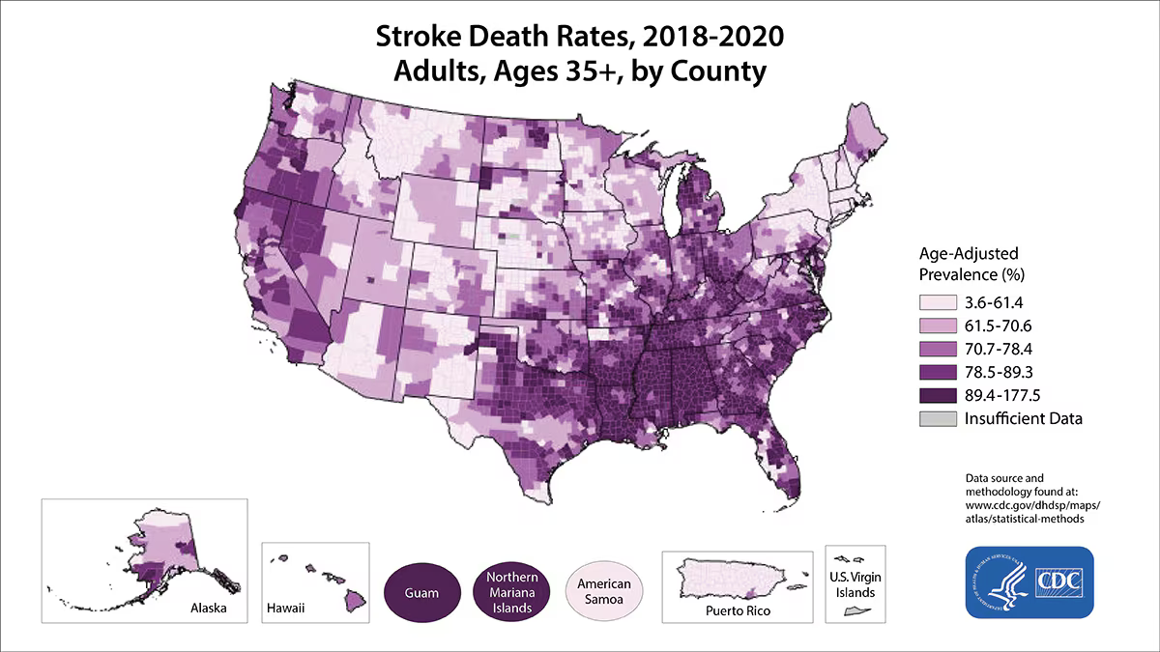
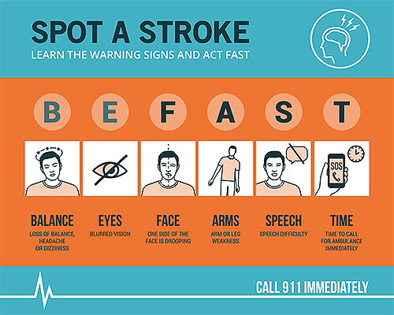
Motivation
According to the CDC, in 2022, the U.S. has 1 in 6 deaths (17.5%) from cardiovascular disease due to stroke. Every 40 seconds, someone in the U.S. has a stroke. Every 3 minutes and 11 seconds, someone dies of a stroke in this country.
Early action is crucial in stroke cases, as the chances of survival significantly increase with immediate emergency treatment. People who arrive at the emergency room within three hours of their first symptoms often experience less disability three months after the stroke.
With today’s technological advancements and the rapid growth of AI, we aim to develop a platform that can detect potential strokes and provide a fast-response system for stroke victims.

Slide 3
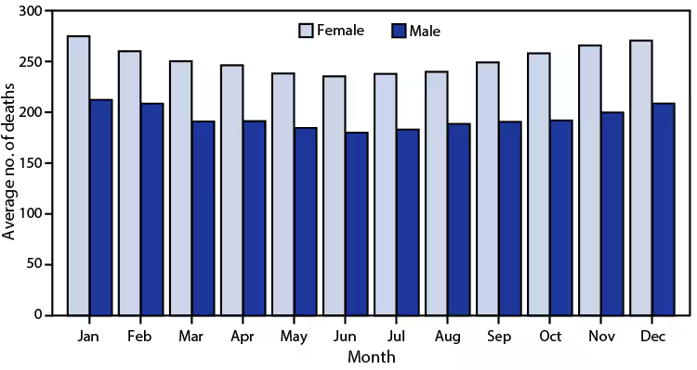
Problem Statement
The importance of early detection and response:
Critical timing: Stroke is a medical emergency where early detection and immediate treatment are essential. Delayed treatment can cause severe disability and death.
Challenges: Many stroke victims do not receive timely treatment due to delays in recognizing symptoms and accessing emergency care.
The role of Data Science:
Advancement in AI: The recent boom in machine learning offers new opportunities for the early detection of stroke symptoms
Urgent response: Innovative solutions that leverage AI to detect potential strokes early and facilitate rapid response.
Statistical facts:
Over half of the stroke deaths occur in women.
More men half stroke, but more women dies with stroke.
Twice of many women die of stroke than breast cancer every year.

Slide 4
Proposal
Development of a Stroke Detection platform:
AI-powered detection: Implement machine learning models to analyze inputs such as medical image, face image, body movement, and vitals sign to detect potential stroke.
Platform: Create a platform (web/app) that allow users or healthcare providers to easily input data and receive real-time feedback.
Fast-response system:
Emergency alerts: Implement a system that automatically show nearby emergency services with the shortest amount of wait time.
Real-time guidance: Provide user real-time guidance with LLM chatbot for recommendation.

Slide 5
Thank you

